Slide 1

“Thank yourself
for being grit so far and till the end”

Slide 2

Building and Testing
RESTFul API (2)

Slide 3
RESTFul API:
Create Resource

Slide 4
Design Endpoint - Add Resource
Action | HTTP Verbs | Endpoints | Controller | Model
Get all resource | GET | /students | index | all
Add resource | POST | /students | store | create
Update resource | PUT | /students/:id | update | update
Delete resource | DELETE | /students/:id | destroy | delete
Get one resource | GET | /students/:id | show | find

Slide 5
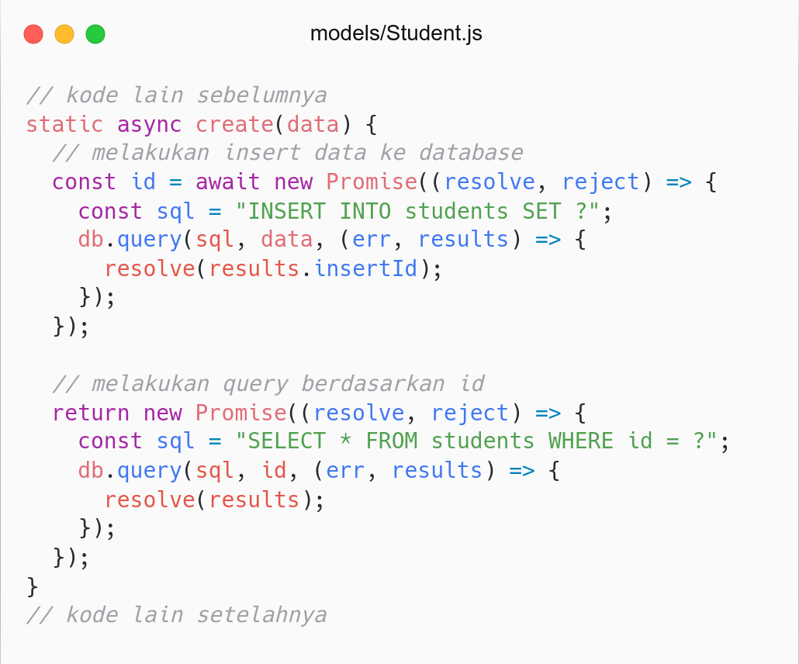
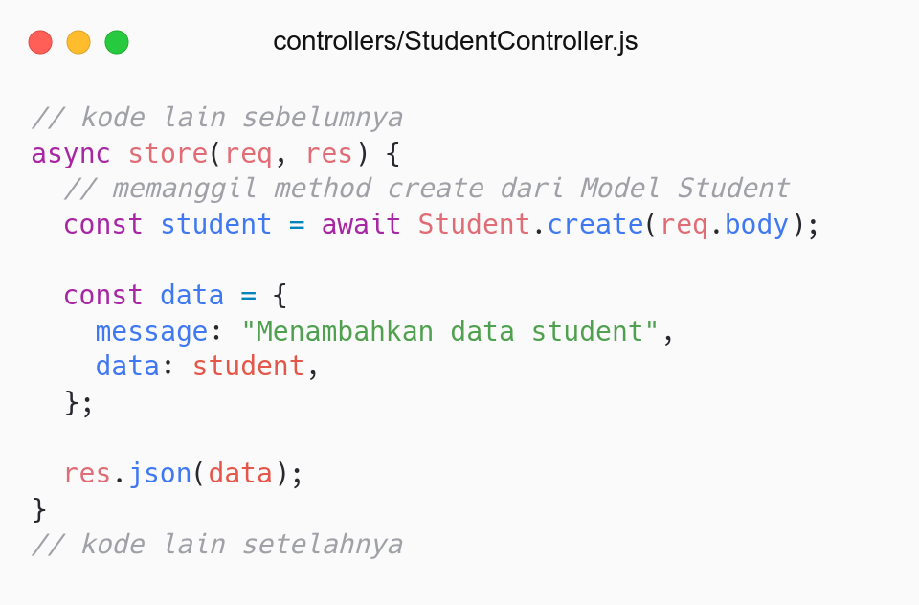
Promise + Async await

Slide 6
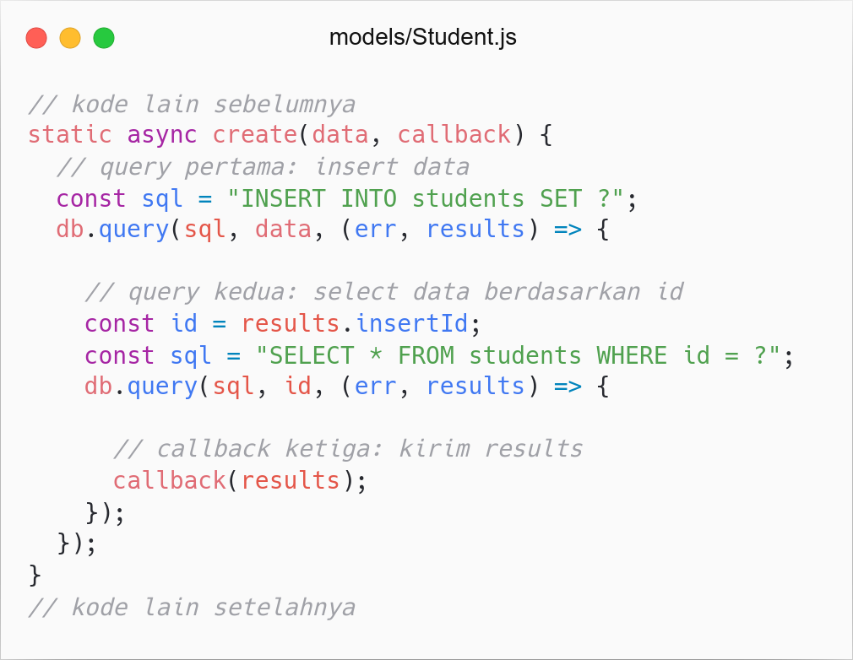
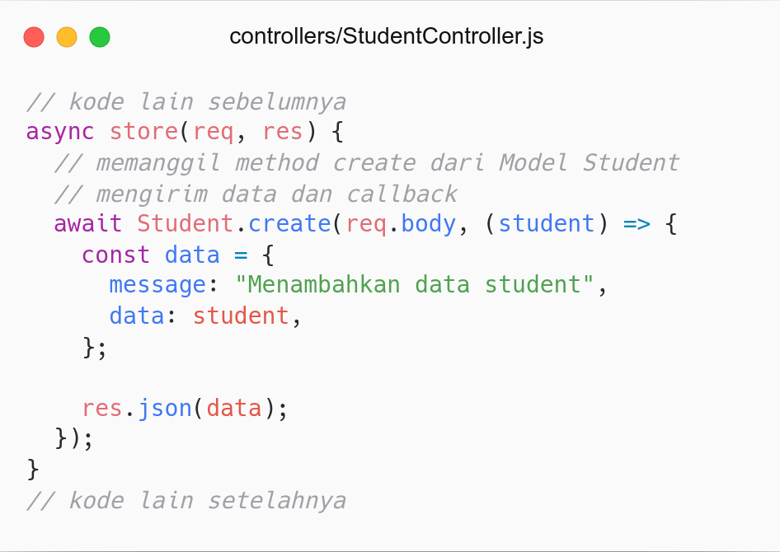
Callback

Slide 7
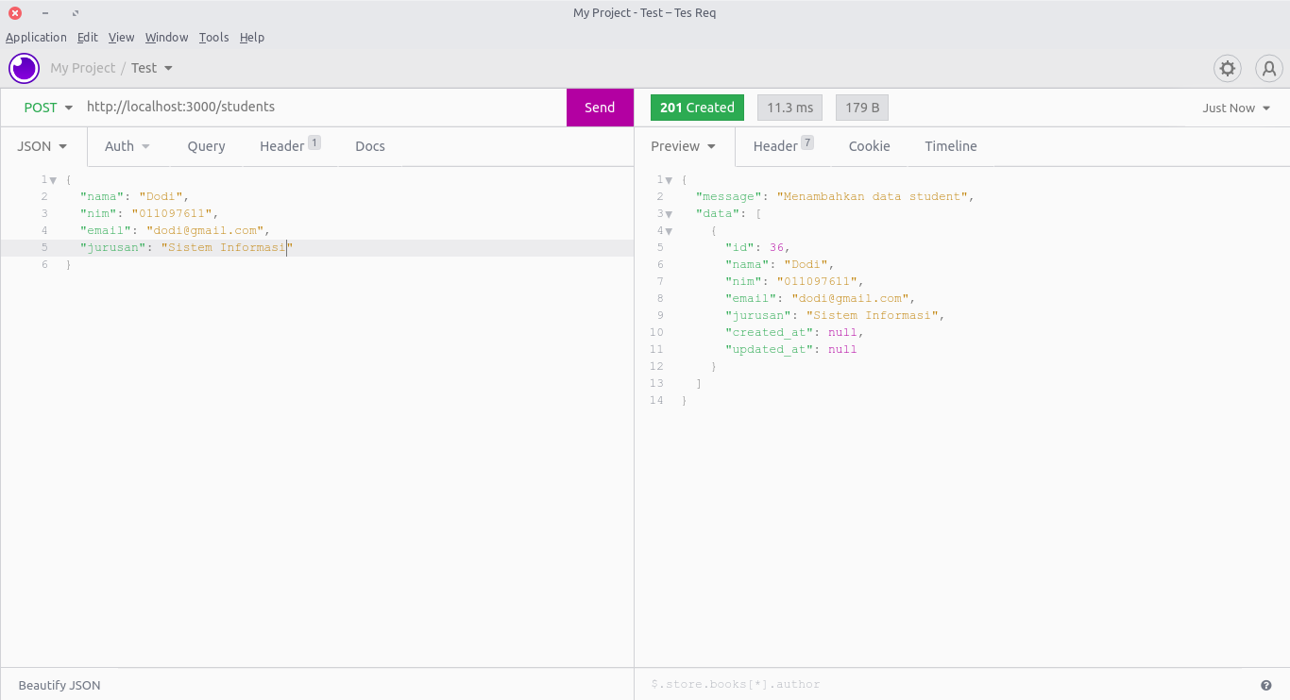

Slide 8
RESTFul API:
Update Resource

Slide 9
Design Endpoint - Update Resource
Action | HTTP Verbs | Endpoints | Controller | Model
Get all resource | GET | /students | index | all
Add resource | POST | /students | store | create
Update resource | PUT | /students/:id | update | update
Delete resource | DELETE | /students/:id | destroy | delete
Get one resource | GET | /students/:id | show | find

Slide 10
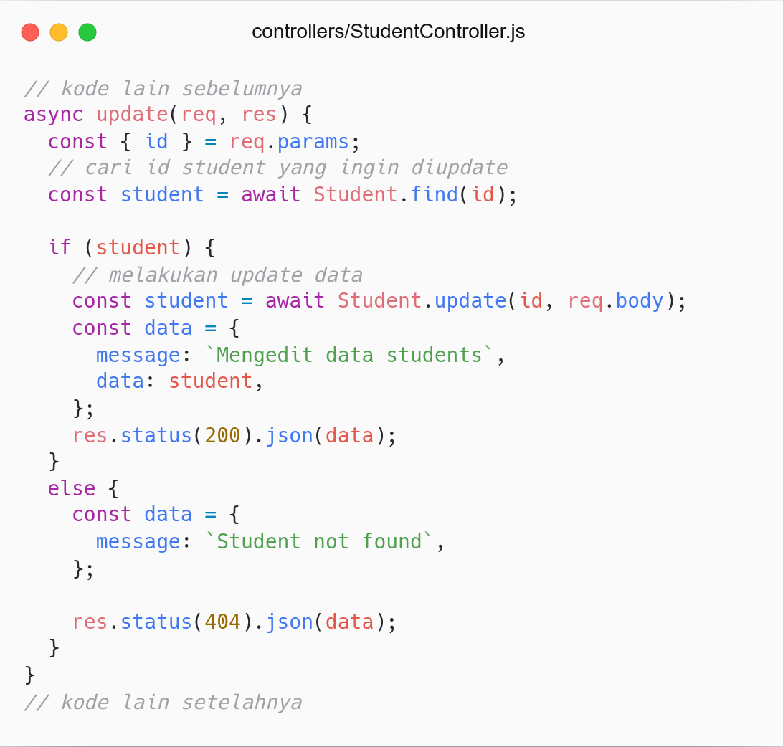

Slide 11
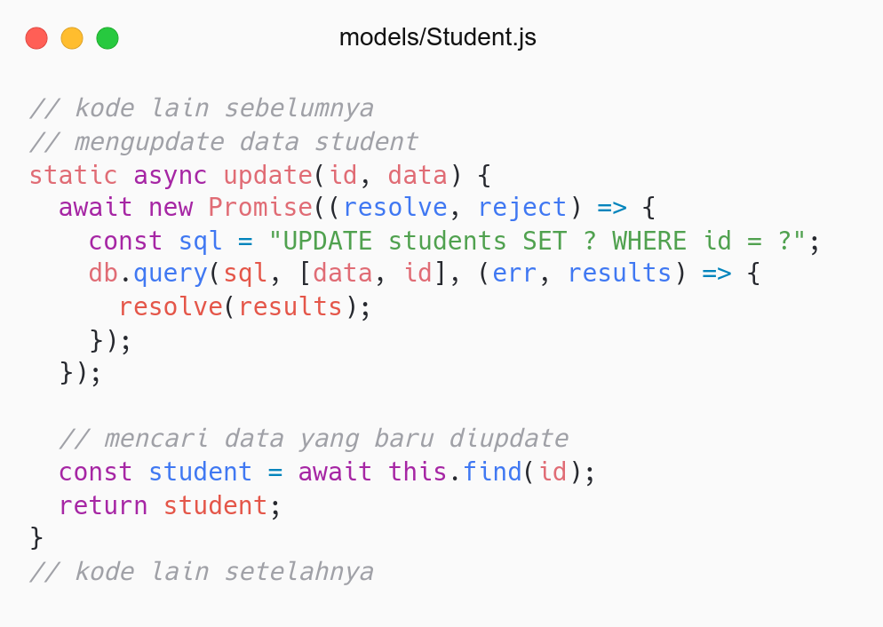
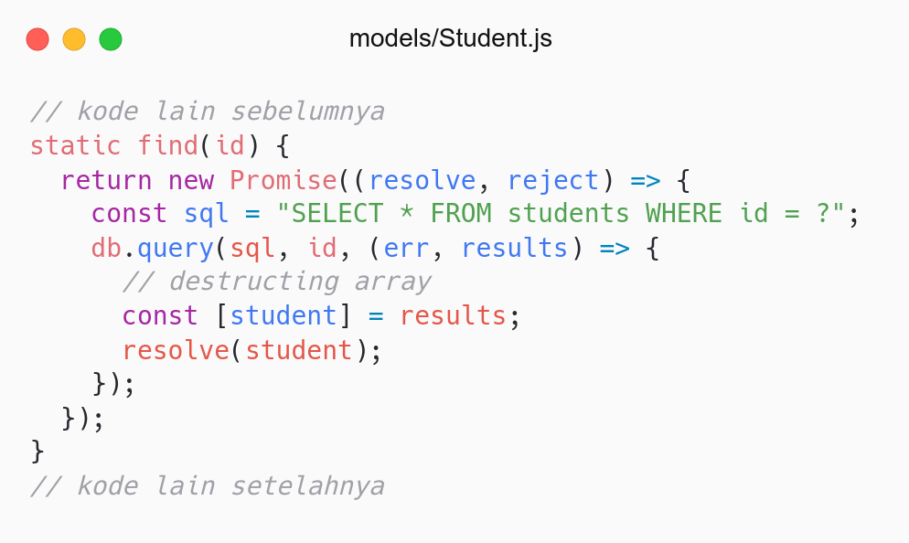

Slide 12
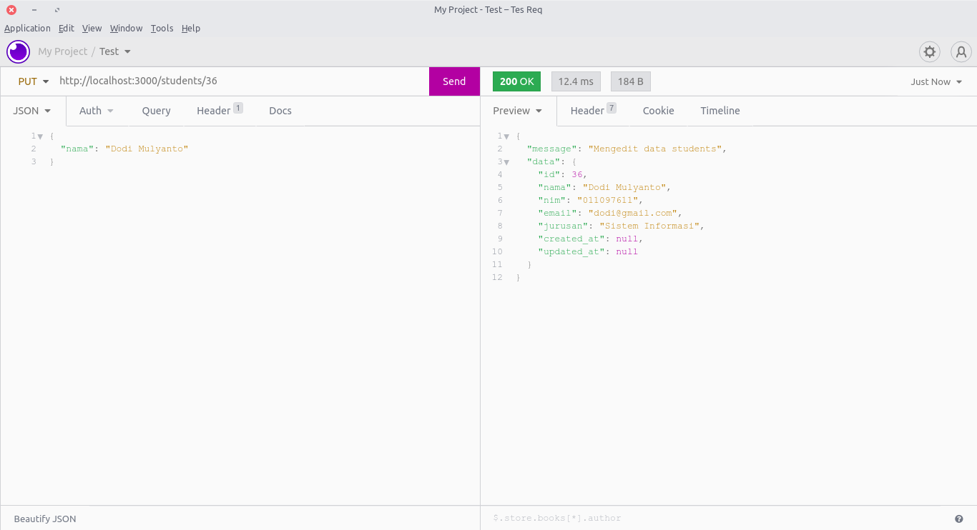

Slide 13
RESTFul API:
Delete Resource

Slide 14
Design Endpoint - Delete Resource
Action | HTTP Verbs | Endpoints | Controller | Model
Get all resource | GET | /students | index | all
Add resource | POST | /students | store | create
Update resource | PUT | /students/:id | update | update
Delete resource | DELETE | /students/:id | destroy | delete
Get one resource | GET | /students/:id | show | find

Slide 15
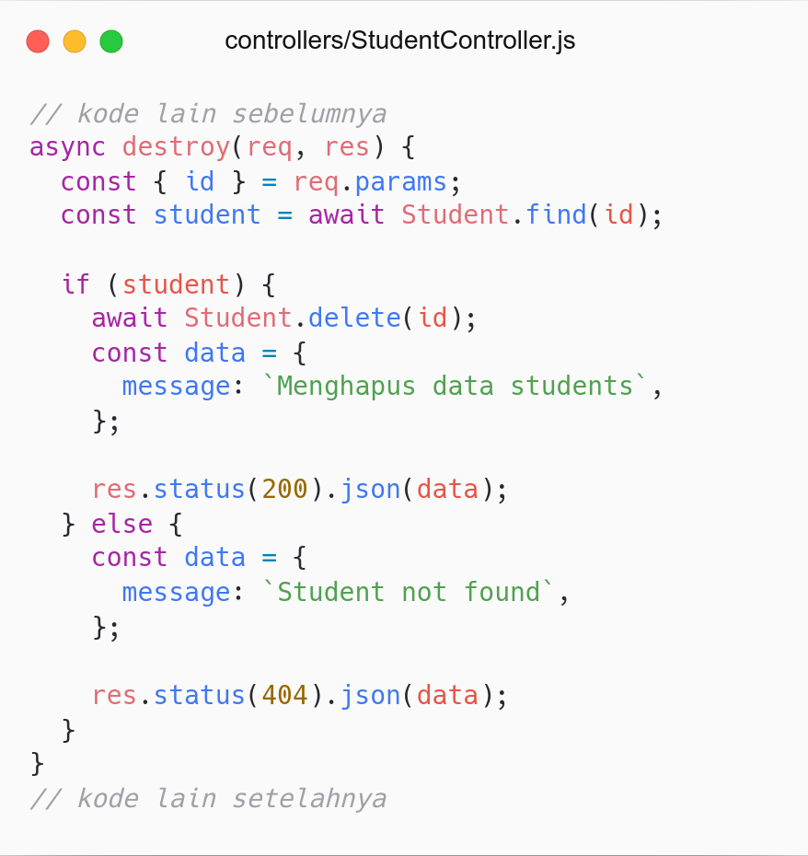
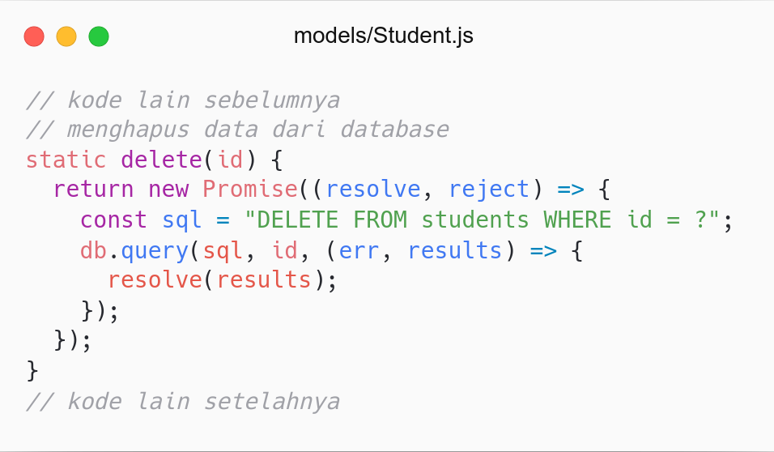

Slide 16
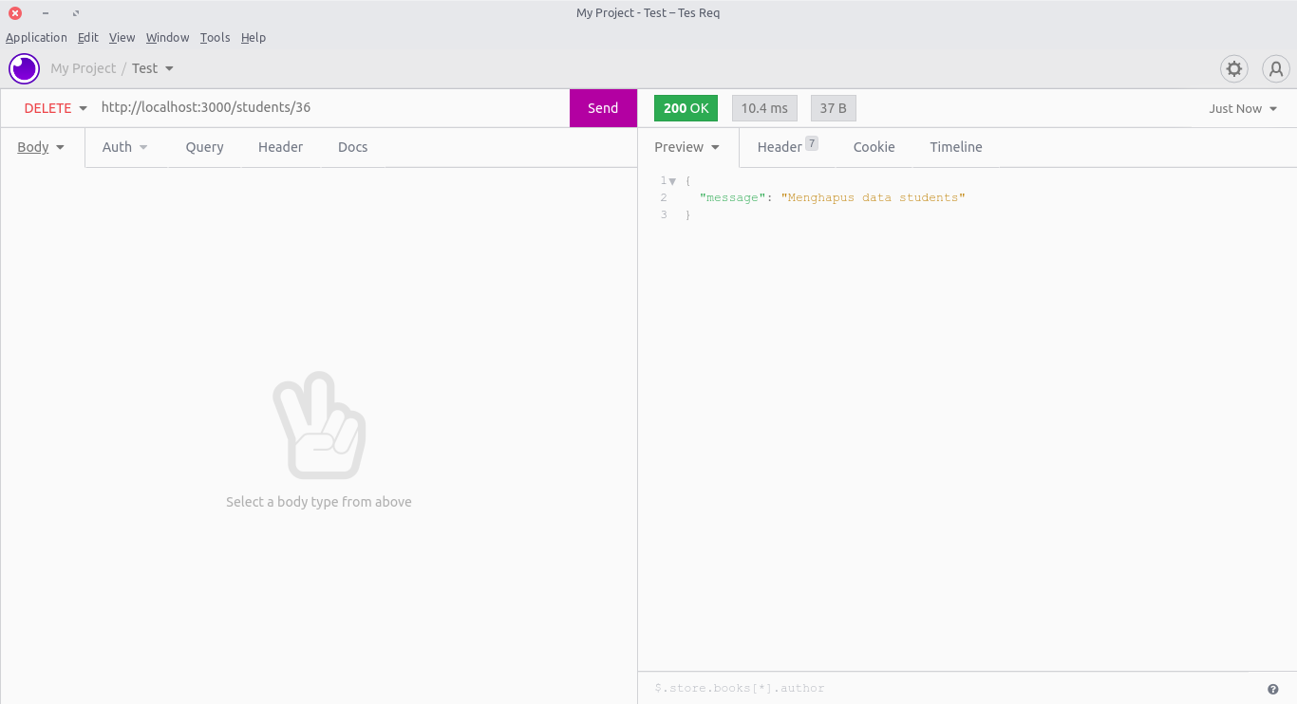

Slide 17
RESTFul API:
Get One Resource

Slide 18
Design Endpoint - Get One Resource
Action | HTTP Verbs | Endpoints | Controller | Model
Get all resource | GET | /students | index | all
Add resource | POST | /students | store | create
Update resource | PUT | /students/:id | update | update
Delete resource | DELETE | /students/:id | destroy | delete
Get one resource | GET | /students/:id | show | find

Slide 19
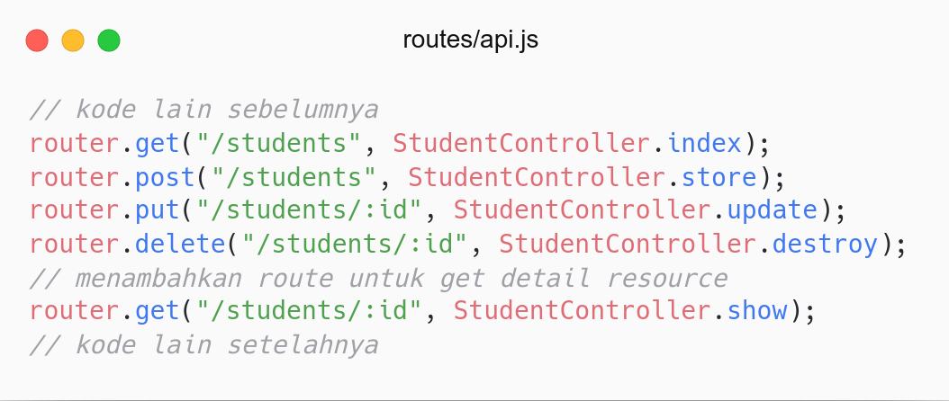

Slide 20
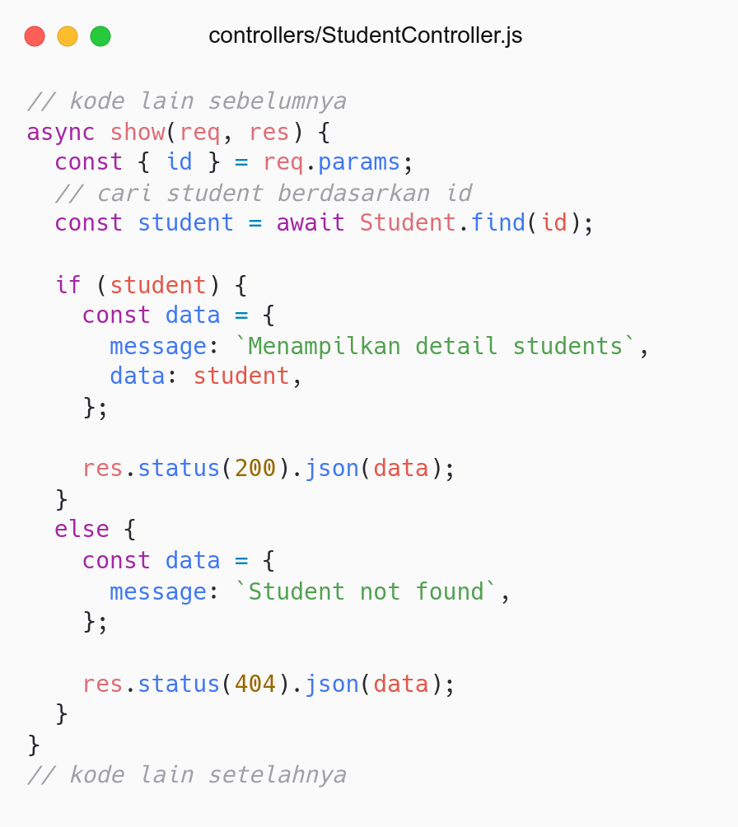
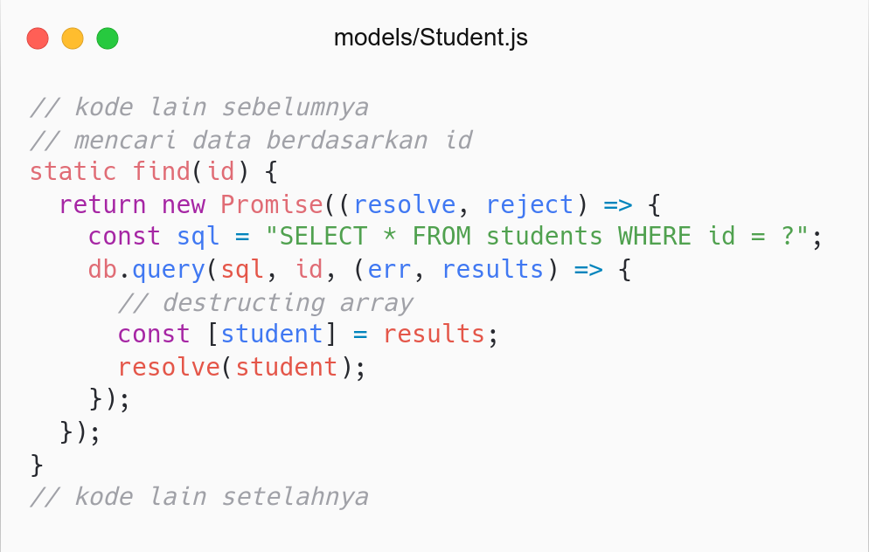

Slide 21
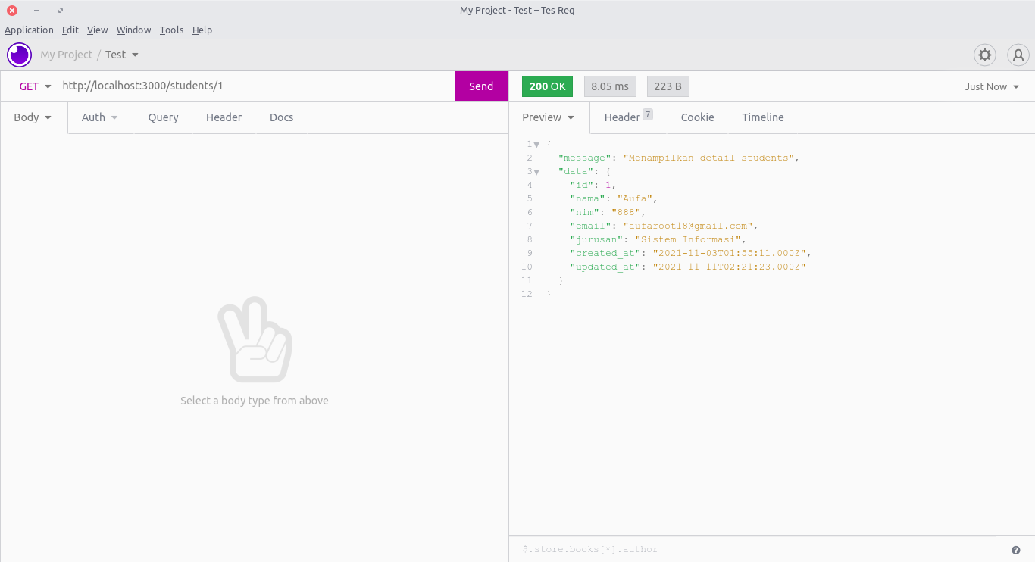

Slide 22
Refactor

Slide 23
Refactor
Controller
index: Menghandle jika data kosong
store: Menghandle jika salah satu data tidak dikirim (validasi)
Model
create: refactor promise 2 untuk select data by id (find)
Others
Clean code
Add authentication: protecting routes
Add complex validation: express-validator

Slide 24
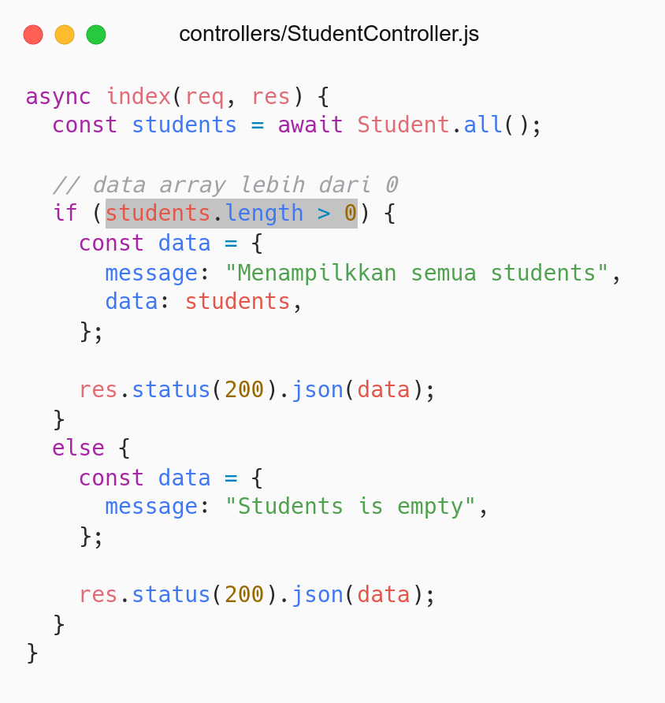
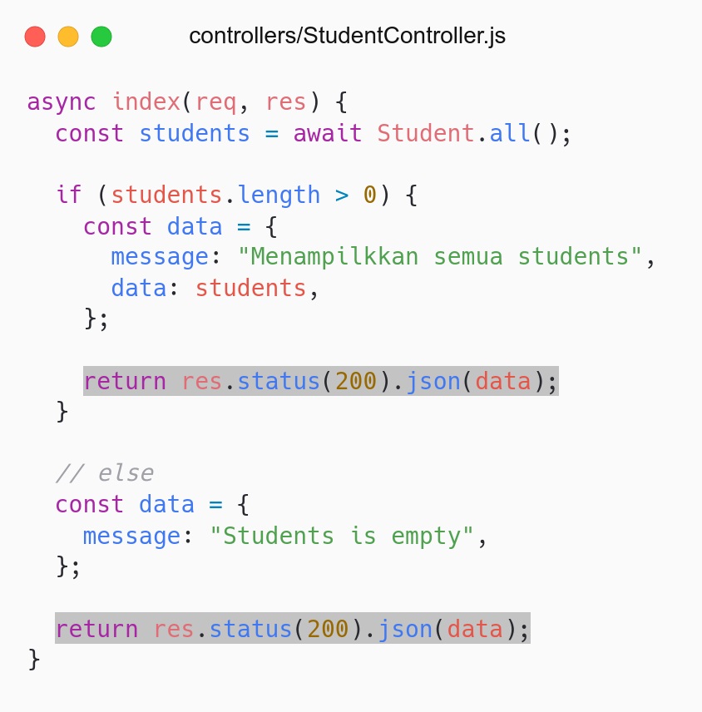
Refactor: handle jika data kosong
Refactor: handle short if else

Slide 25
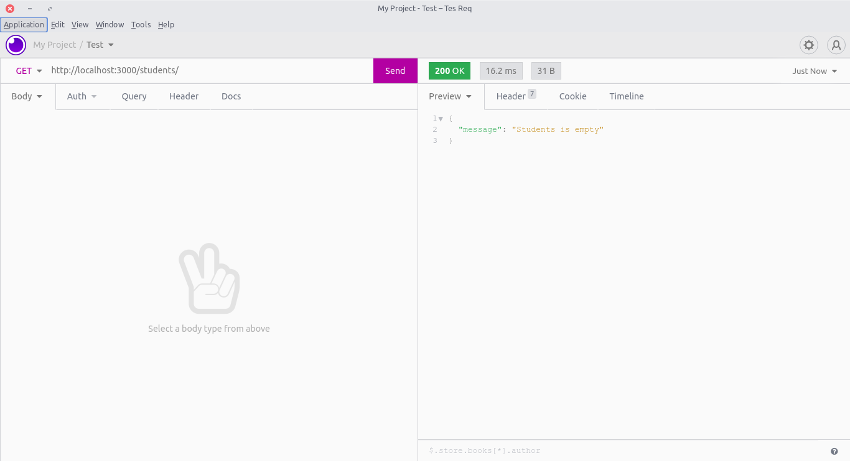

Slide 26
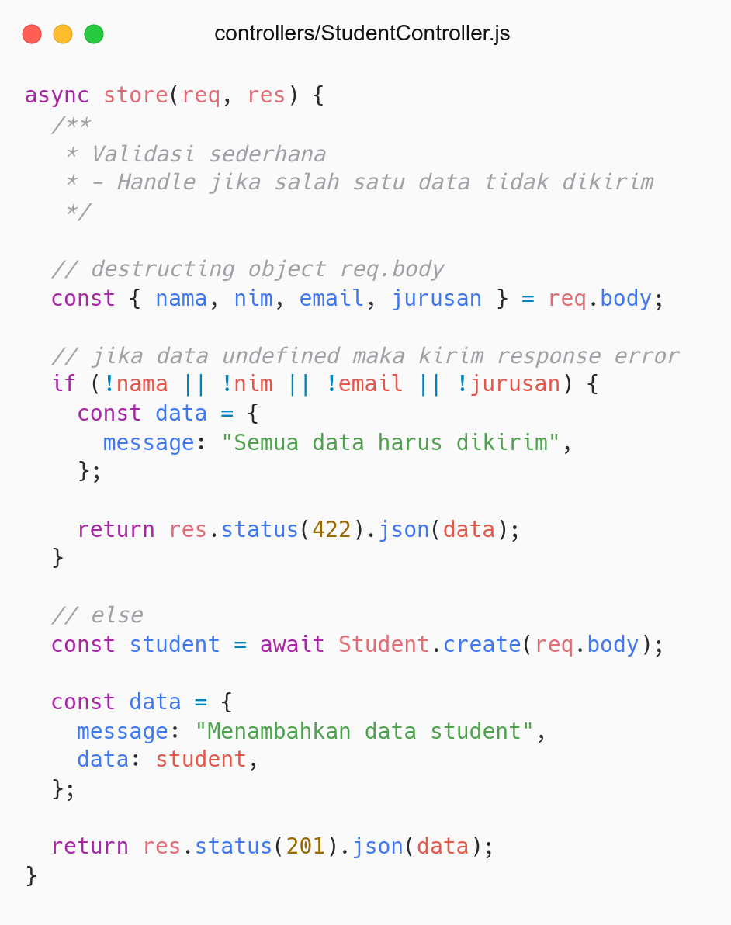
Refactor:
Menambahkan validasi sederhana (jika data tidak dikirim).
Handle short if else.
Validasi yang lain:
Handle jika data kosong.
Handle nim harus berupa angka.
Handle format email harus benar.
dll.
Complex Validation:
Validasi yang lebih kompleks bisa dilakukan secara manual atau menggunakan package lain.
Terdapat package untuk menghandle validasi yang lebih kompleks.
Package: express-validator

Slide 27
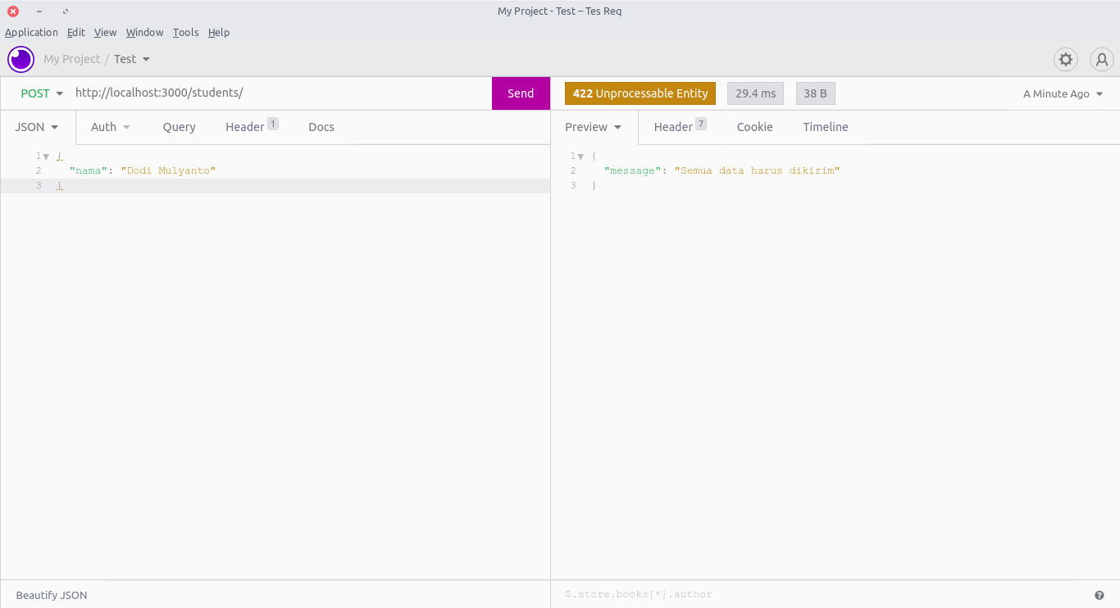

Slide 28
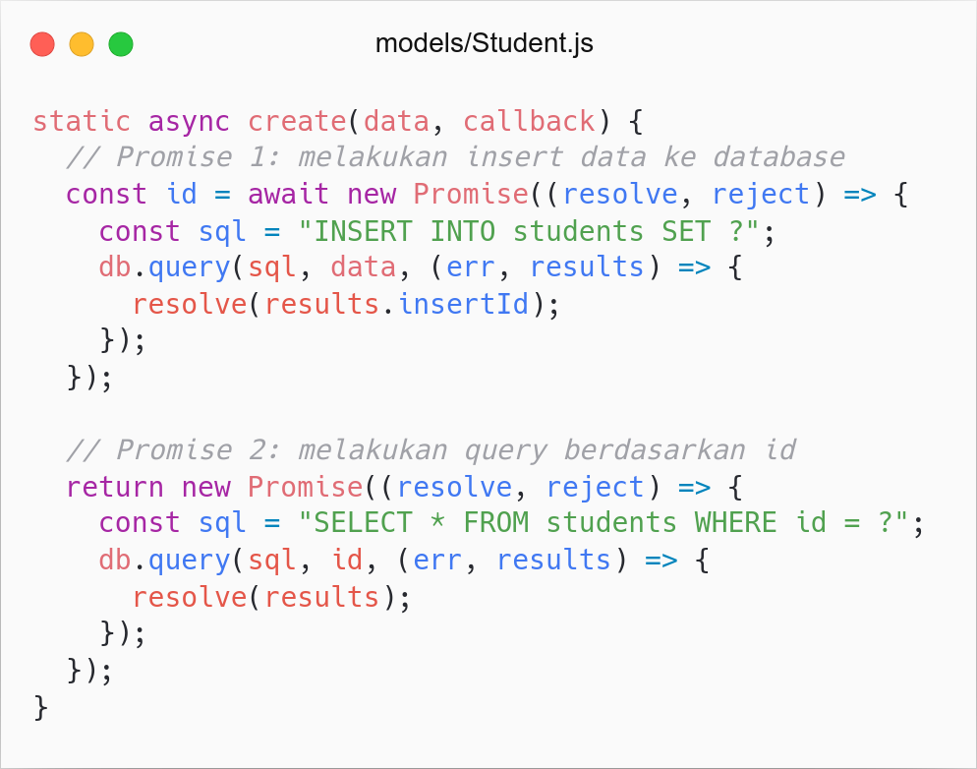
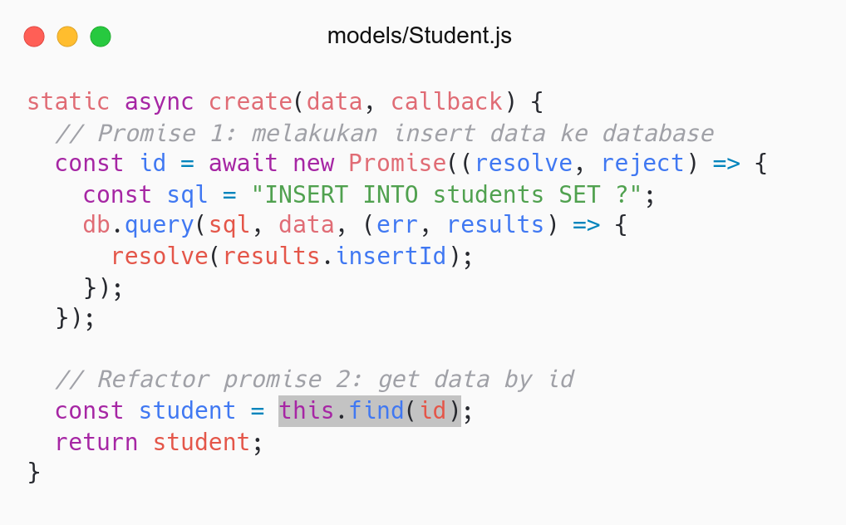
Kode sebelumnya
Refactor: ubah promise 2 menggunakan find

Slide 29
Useful Package

Slide 30
Useful Package
sequelize: Eloquent untuk database SQL di Express.js.
express-validator: Membuat validasi yang kompleks.
jsonwebtokens: Menambahkan authentication untuk RESTFul API.
body-parser: Mengubah data request ke object (pengganti middleware default express).
bcrypt: Hashing password user sebelum disimpan di database.

Slide 31
Congratulations

Slide 32
Recap Our Journey in Backend Programming
Belajar konsep dan implementasi RESTFul API
PHP:
PHP Basic
PHP OOP
Laravel
Framework Laravel
Implementasi RESTFul API menggunakan Framework Laravel
Membangun Proyek Akhir Covid API menggunakan Framework Laravel
JavaScript
JavaScript Basic
JavaScript Modern ES6
JavaScript Asynchronous
Express.js
Framework Express.js
Implementasi RESTFul API menggunakan Framework Express.js
Membangun Proyek Akhir Covid API menggunakan Framework Express.js
Belajar menerapkan Arsitektur MVC dan Paradigma OOP from scratch di Framework Express.js

Slide 33
“Thank yourself for being grit so far and to the end.
You have learned a lot, take a breathe for now.
If this is your passion, let's continue your journey to advanced learning.
Otherwise, keep exploring your passion.
Good luck to all of you.”
Regards, Aufa Billah (Your Coding Friend). ♥

Slide 34
Task

Slide 35
Task
Lengkapi seluruh fitur yang ada pada API
Testing seluruh Endpoint
Refactor code
Ketentuan:
Upload Task ke Github
Kirim link repository ke Elena: Link

Slide 36
Referensi
Express.js: Documentation

Slide 37

Feedback Form (Absensi)

